Slide 1
Chat App – an iOS based chat application
Team Members
Son Thai
Nikita Mathur
Sagar Manglani
Neha Ramachandra
Purnima Upadhyaya

Slide 2
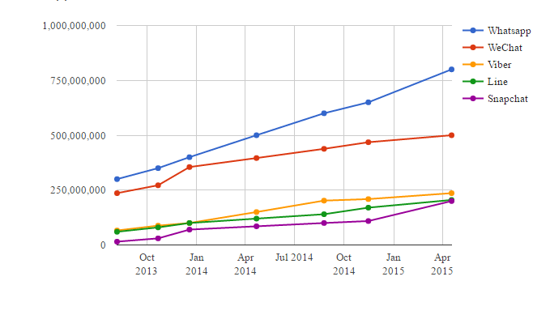
introduction
Offers real-time communication
Cheap alternative to text based messaging
Offers more privacy than social networks
Notes:
References
https://contently.com/strategist/2015/06/30/the-state-of-messaging-apps-in-5-charts/

Slide 3
System Overview

Slide 4
High-Level Architecture

Slide 5
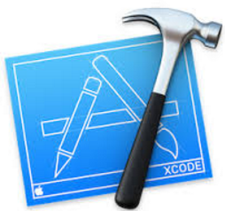





Technologies Used
Xcode
Swift
Parse
Objective-C
Open Talk
Heroku

Slide 6






Features
3
2
4
Profile Picture
One – to - One Chat
Push Notifications
Chat App
1
5
Voice Call
Video Call

Slide 7
Future Enhancements
App to app calls
Status of the user
Custom status messages
Archiving messages
Group Chats

